Slide 1
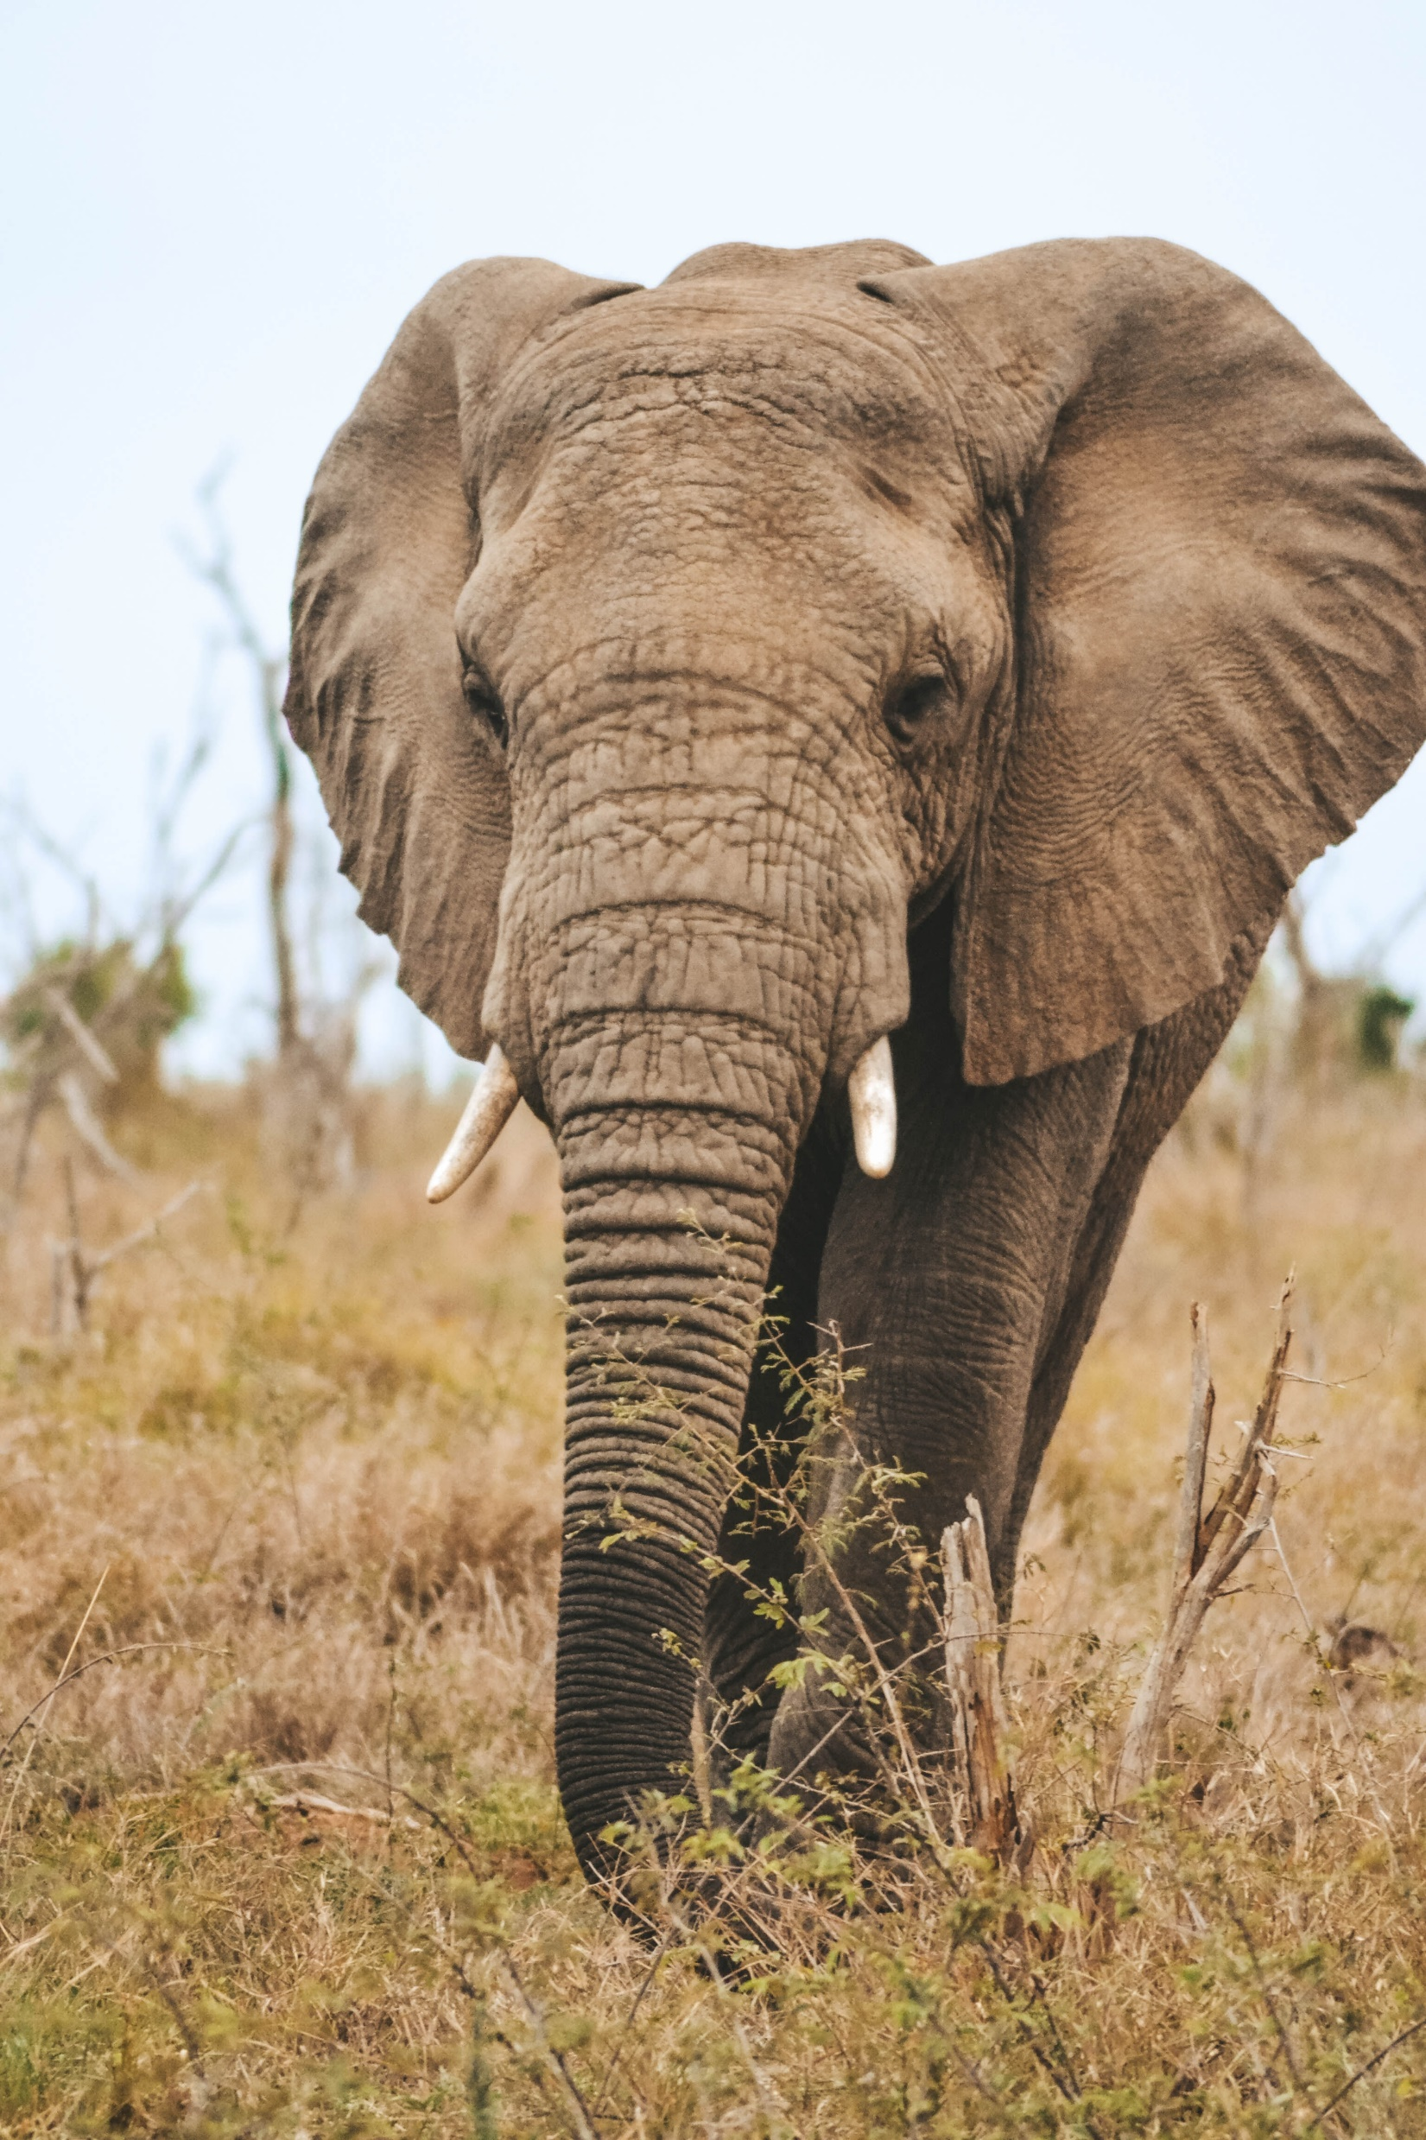



WildTask
Sponsored By
Team Lambda++
Team 18
Gage Nott
Kevin Kiyo
Abu Zar Bulbulia
Ariel Sischy

Slide 2
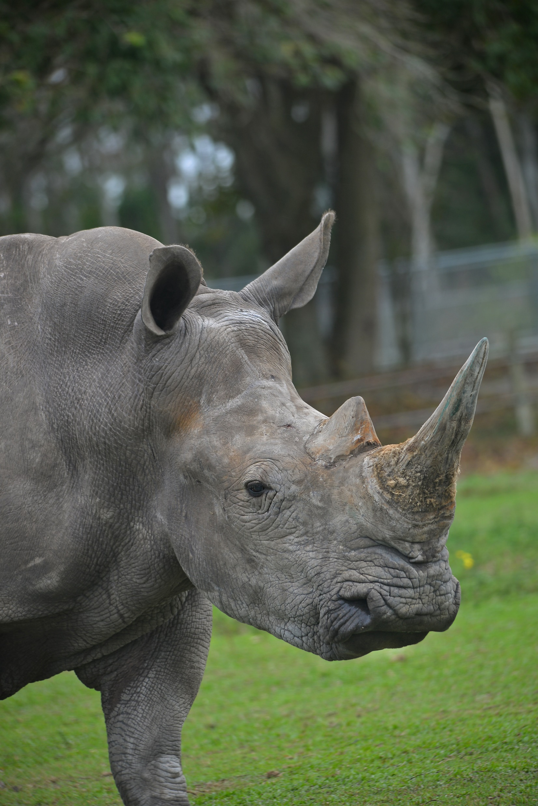
Background
Elephant and rhino reserve with community partnership.
Managed by non-profit company ERP with 90-year lease.
Economic opportunities for community, wildlife conservation.
30+ employees, potential for expansion, team-based work.

Slide 3
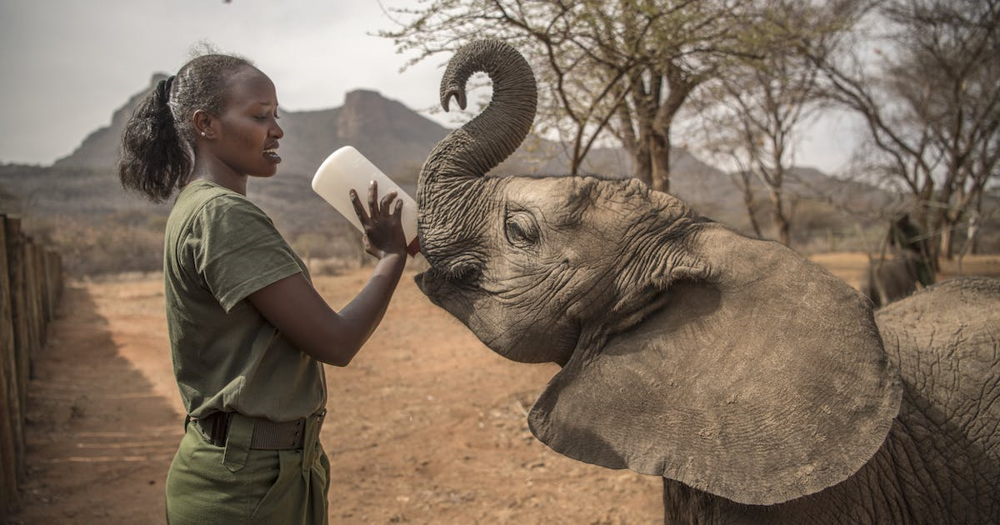
Problem Statement
Administrator faces challenges managing reserve activities.
No system for activity assignment and progress tracking.
Employees' skills and availability not tracked.
Lack of formal resource tracking and requesting system.

